Slide 1
Body Language
By Jason Palmeri
Assignment 4.3

Slide 2
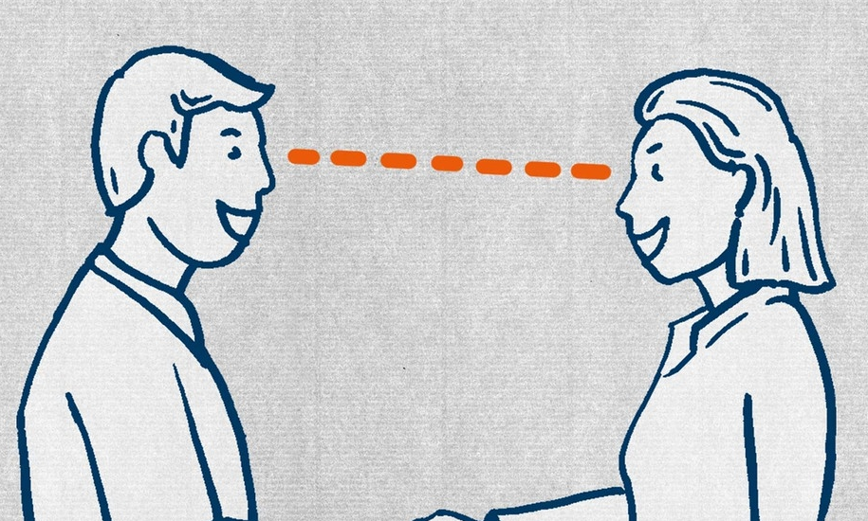
How Body Language Impacts Communication
Eye Contact
Eye contact is one of the first levels of connection that you share with another person. Eye contact happens before you even say anything to them. Eye contact is an unambiguous gauge for expressing attentiveness, confidence, and sincerity.

Slide 3
How Body Language Impacts Communication cont.
Facial Expressions
Facial expressions are critical to competent communication. It’s important to be aware of how to express genuine reactions, remember that no matter what you say, you’ll lose credibility if your face tells a different story.
Voice
Voice is an important aspect of body language. It’s your responsibility to convey exactly what you mean, so it’s important to consider what your are meaning to say and take your time to think out what you are going to say.

Slide 4
How Body Language Impacts Communication cont.
Posture
Your posture says a lot about who you are, and whether you should be taken seriously. If you are trying to look more professional it’s important to stand up straight, to communicate confidence.
Gestures
Gestures are an extension of communication whose purpose is to enhance verbal communication. It's about showing, and not telling, which adds a layer of engagement for the listener.

Slide 5
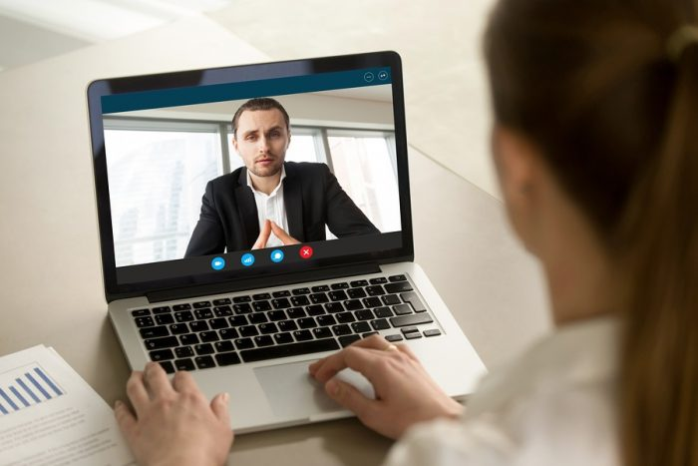
Strategies for improving body language in a virtual environment
Posture
When attending virtual meetings you no longer need to be wearing pants. Basically it’s not about how you look, it’s about the way you look. Posture is important, it shows how engaged you are in the meeting. Being slouched back or leaned on your desk makes it look as though you are bored and disinterested. It’s important to relax and expand your shoulders to show you are confident and fully engaged in the meeting, boosting your confidence and showing those in the meeting that you are engaged.

Slide 6
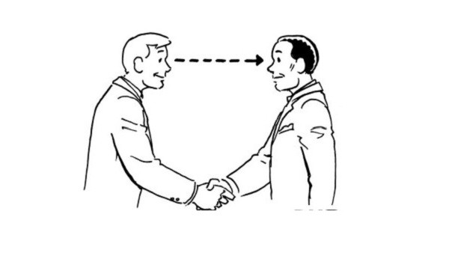
Strategies for improving body language in a virtual environment cont.
Smile
Smile when you are attending virtual meetings, even if they are with people you already know or a new client or employee, make them feel welcomed and greet them with a smile. But don't over smile, as it may come across as fake.
Eye Contact
This is important in virtual meetings ,as it can be easy to distract yourself from the meeting, with multiple monitor setups it's easy to have something else on your other monitor distract you. It's important to stay focus on where your meeting is taking place, and to place your camera above the meeting program and not on another monitor.

Slide 7
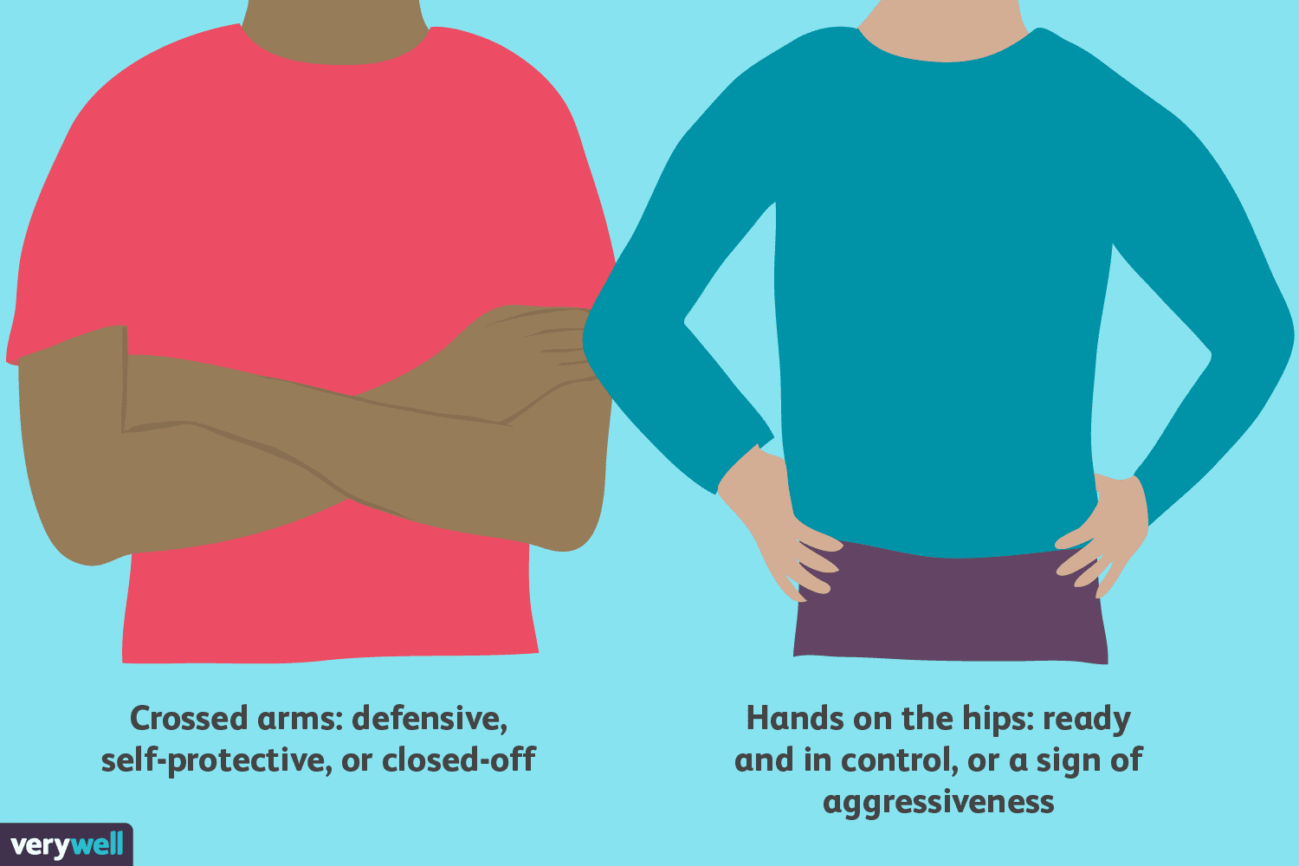
How our emotions impact body language during conversations.
“Body language alone can make or break a conversion. According to Psychologist World, human communication is 20% verbal, and 80% non-verbal” (Fierce, 2021). Body language that doesn’t coincide with the message we intend to send can lead to relationship ruptures, misunderstandings and unwanted outcomes. When we are under a lot of stress we tend to do things in a hurry and mess things up. When we are angry we tend to either produce sloppy outcomes or get mad at the person who is asking us to do more. “A study by researchers at the Hebrew University of Jerusalem and at New York University and Princeton revealed that body language is an even more accurate determiner of judging emotion than facial expressions”. (Fierce, 2021)

Slide 8
Citation
Mariama-Arthur, K. (2015, May 19). Five aspects of body language that affect business communication. Black Enterprise. Retrieved October 29, 2021, from https://www.blackenterprise.com/body-language-tips-business-communication-office/.
Cole, B. M. (2021, June 30). 8 top tips for improving your body language during virtual meetings. Forbes. Retrieved October 29, 2021, from https://www.forbes.com/sites/biancamillercole/2020/09/17/8-top-tips-for-improving-your-body-language-during-virtual-meetings/?sh=5c14bab71f2a.
Fierce, F. (2021, October 7). How your body language impacts workplace conversations. Fierce. Retrieved October 29, 2021, from https://fierceinc.com/blog/how-your-body-language-impacts-workplace-conversations/.

